Slide 1
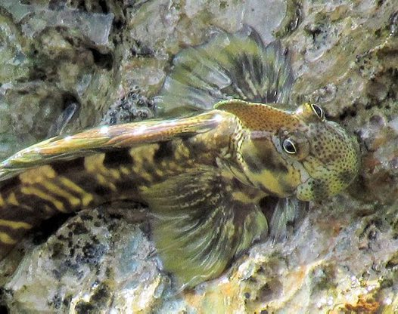
Fish out of water
By: Melissa Moreno
Leaping Blenny!

Slide 2
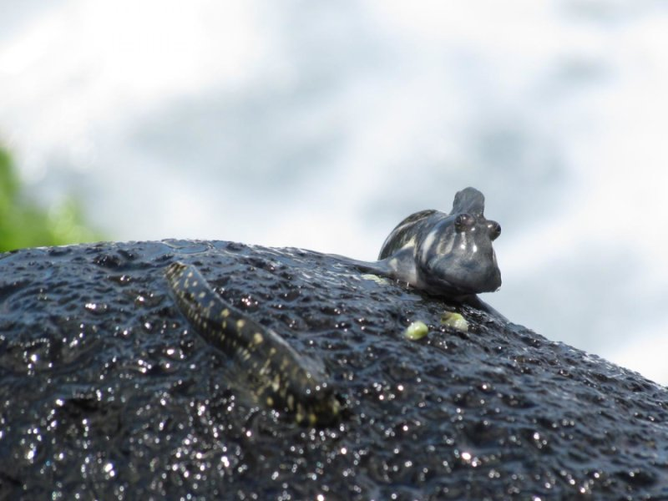
Reasons for emergence
Fish in fringe habitats could explore other environments, i.e intertidal zones.
Fish can voluntarily strand themselves to avoid hypoxia, a very common cause for emergence.
Fish that live close to substrate are more likely to be better suited for an emergence compared to pelagic fish.
Fish that do not rely on mobile prey might be more readily able to transition to a terrestrial environment.

Slide 3
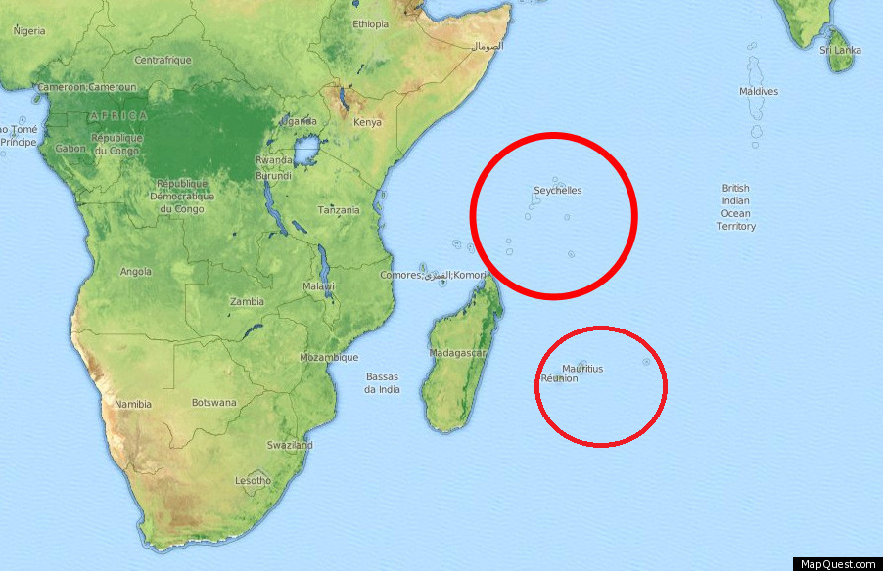
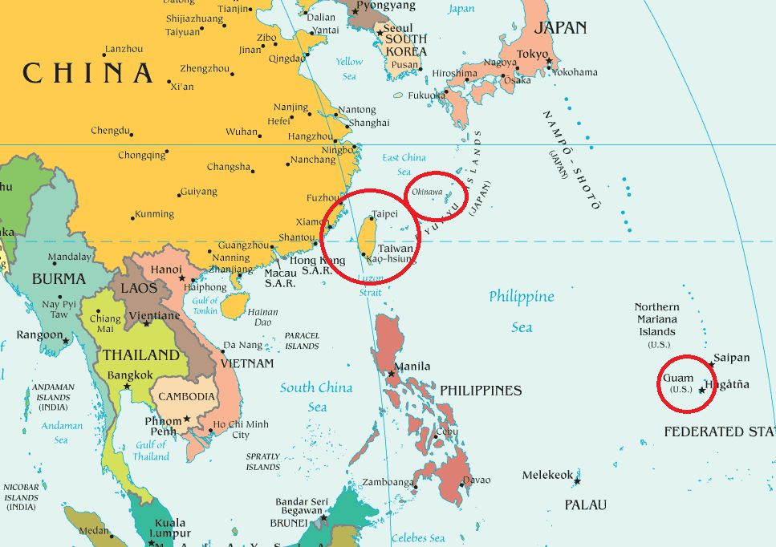
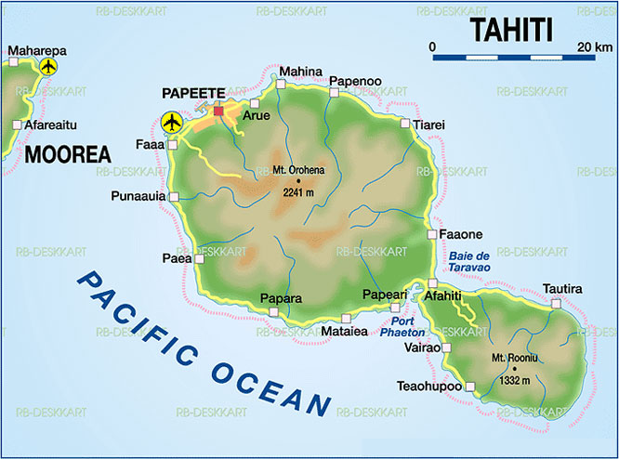
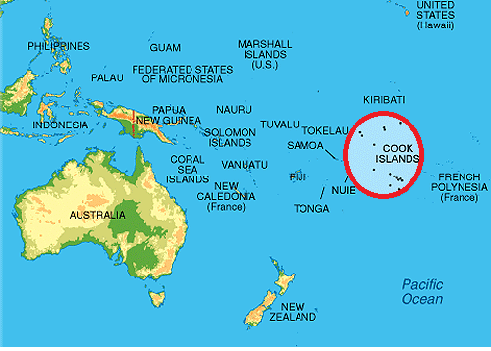
Where was the blenny observed

Slide 4
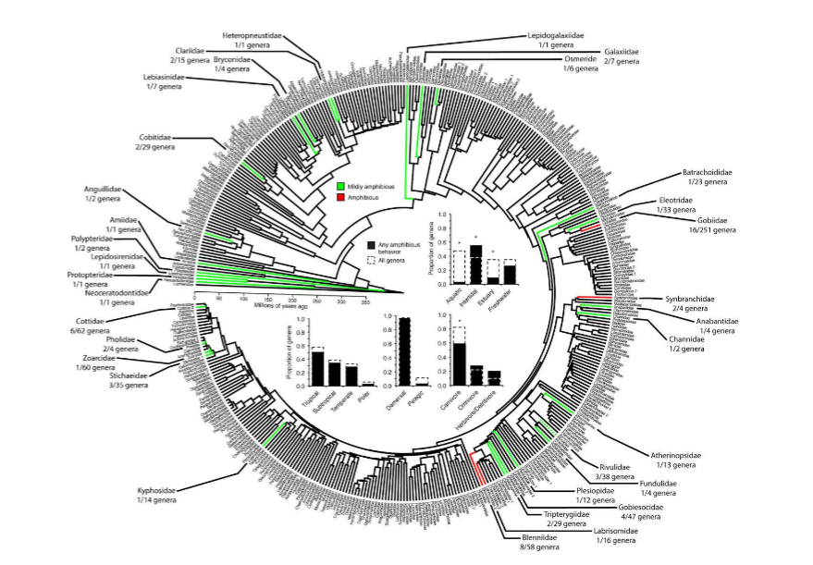
Constructed phylogeny of all fishes
T. J. ORD AND G. M. COOKE
Figure 1. Phylogeny and general ecology of amphibious behavior in all ﬁshes. Highlighted in color are the 33 families in which at least one species has been reported to exhibit amphibious behavior (see Table S1). Color codes provide a general indication of the maximum level of amphibious behavior reported for species within those families. This ranges from “mildly amphibious” in green—species known to voluntarily strand themselves on land as water bodies recede, or actively leave water for brief terrestrial excursions (lasting seconds to minutes)—to “amphibious” in red—species that are highly active on land for extended periods (hours; see Table S1 for details).
Also shown is the number of genera represented by amphibious species relative to the total number of described genera within each family. For example, in Gobiidae there were 16 genera of the total 251 genera described within this family with species reported to be amphibious. In histograms, the black bars show the proportion of genera with at least one amphibious species categorized by habitat,climate, habit, or diet (see Table S1). Some genera had amphibious species represented in more than one category, so proportions across categories sum to a value greater than 1. Dashed bars in histograms indicate the proportion of all described genera—amphibious and nonamphibious—within these same families. Asterisks highlight instances in which the number of amphibious genera within a given
category differs signiﬁcantly from the total number of genera in those families that occur in this category more generally. The phylogeny was provided by Ricardo Betancur-R and is described in Betancur-R et al. (2015).

Slide 5
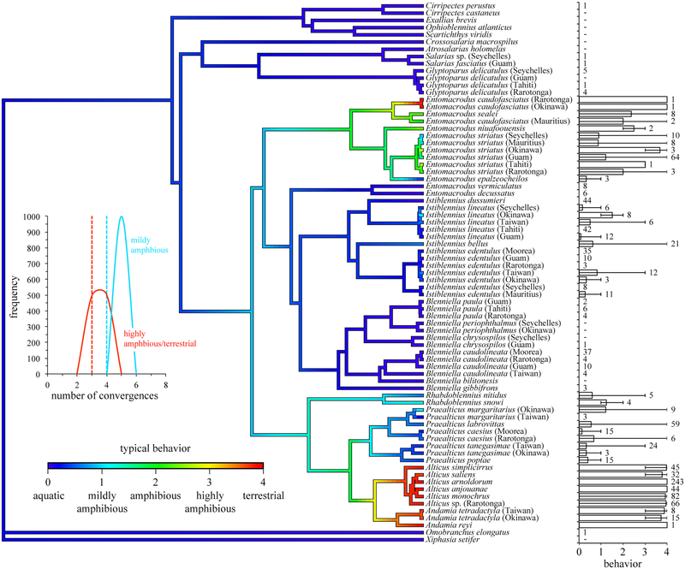
Figure 2. The evolution of amphibious behavior in Blenniidae. The phylogeny shown is the Bayesian inference of the partitioned
concatenated dataset (see Supporting Information for reconstructions based on other methods). Reconstructed onto this phylogeny is the mean (typical) behavioral rating measured for each taxa based on the coding described in Table S2. The histogram at the tips of the phylogeny provides the mean, minimum, and maximum values of this rating. Numbers alongside histogram bars are the number of individuals sampled within taxa. Those taxa with “-” are known to be exclusively aquatic and were included in the phylogeny using tissue samples from donated specimens (all collected using SCUBA). The inset reports the number of convergences in a highly amphibious/terrestrial lifestyle or mildly amphibious lifestyle recovered across the consensus tree (dashed vertical lines) or from 1000 samples of the posterior distribution used to create the phylogeny (solid lines).

Slide 6
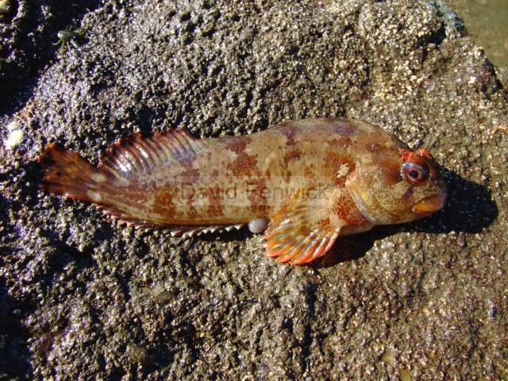
Thoughts?
“The phenomenon of a fish out of water might seem extraordinary given the dramatic differences between an aquatic and terrestrial environment, but it is in fact quite common.”

